Slide 1
BQ: A Lock-Free Queue With Batching
Based on Article
by Gal Milman
et el. 2018

Slide 2
TABLE OF CONTENTS
01
02
03
ABOUT THE PROJECT
IMPLEMENTATION AND CHALLENGES
PERFORMANCE AND USING EXAMPLES
What is the project about
How we implemented and what were the challenges, optimizations and additional features
What is the performance of the project and its use

Slide 3
ABOUT THE PROJECT
01
Definitions
What is Batch Queue
Batch Queue adventages
Batch Queue design

Slide 4
DEFINITIONS
LOCK-FREE
QUEUE
BATCHING
Lock-free means a thread-safe access to shared data without use of synchronization primitives such as mutexes
Queue is a collection of entities that are maintained in a sequence and can be modified by two operations: “enqueue” – which adds entities to the head of the sequence.
“dequeue” – which removes entities from the tail of the sequence.
Batching means grouping a sequence of standard operations to a single
batch operation, which applies them together to the shared object.

Slide 5
WHAT IS LOCK-FREE QUEUE WITH BATCHING
As its name implies, it’s a lock-free queue that is using atomic CAS (Compare And Swap) and supports future operations.
ITS ADVENTAGES
BQ (Batch Queue) exploits batching to reduce contention and improve scalability. It enables a fast application of a mixed sequence of enqueue and dequeue operations all at once to the shared queue. Thus, it significantly reduces accesses to the shared queue and overall processing in it. BQ demonstrates a substantial performance improvement compared to other lock-free queues.

Slide 6
THE IDEA OF USING BATCHING
The idea of this queue is described in detail in the article “BQ: A Lock Free Queue With Batching”.
We would like to introduce it briefly.
Lock-free queue is well-known, like MSQ. This Batch Queue extends the MSQ, and supports using future operations. This These future operations allow to execute several operations on the queue at once, which can reduce the number of atomic operations, and therefore leads to better performance.

Slide 7
HOW IT IS DESIGNED
To support batching we use thread data structure for each thread that saves queue of the future operations. Every call to future enqueue or future dequeue is added to this queue.
In addition, we keep a simple linked list of the items to be enqueued later.
To execute a batch, we will call an evaluating function that creates a batch request with all the data for its execution, such as the linked list of the enqueue items, number of dequeues, enqueues and excess dequeues. Then we replace the head of the shared queue with announcement, containing the data, with the old data of the queue (the old head and the old tail).

Slide 8
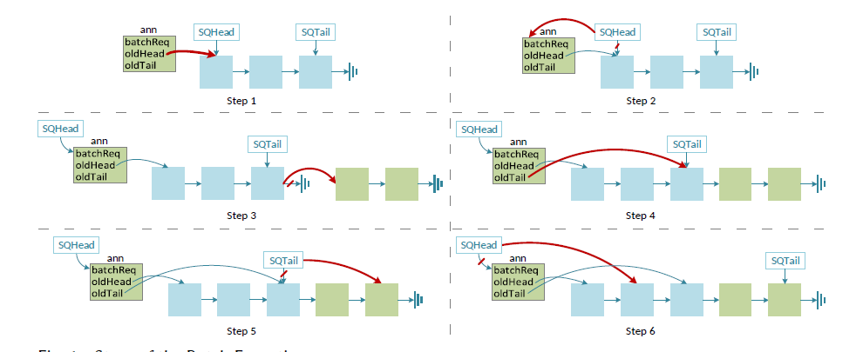
HOW IT IS DESIGNED
In the graph bellow we can see how the batch executing is operated, as described in the article:

Slide 9
IMPLEMENTATION AND CHALLENGES
02
How it was implemented
How it is compiled
What libraries were used
Challenges

Slide 10
HOW IT WAS IMPLEMENTED
DATA STURCTURES
METHODS
We have created a Queue class, which contains an atomic PtrCntOrAnn for the head, and atomic PtrCnt for the tail.
PtrCnt is a pointer to a standard node (whose next is atomic), and a counter. PtrCntOrAnn is a union of PtrCnt and a pointer to announcement, which contains a Batch Request instance with all the details required to execute the batch operation it stands for.
It also contains memory management data structures to avoid memory leaks, and also an attribute that holds the number of threads using this Batch Queue.
There are 5 methods which are exposed to the user:
Enqueue
Dequeue
FutureEnqueue
FutureDequeue
Evaluate
At this part, we will explain and show their implementations.

Slide 11
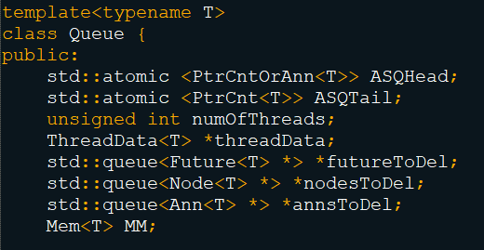
QUEUE

Slide 12
ADDITIONAL DATA STRUCTURES
ANN
FUTURE
THREAD DATA
FUTURE OP
BATCH REQUEST
PTRCNT
A Batch Request and a pointer to the old head and a pointer to the old tail.
Non thread-safe queue, for future operations, pointers to enqueue Head and Tail, and unsigned integers noting enqueue/dequeue/excess dequeue, numbers. As well as warning flag and hazard pointer to node/ann.
A pointer to an item, and a boolean flag that notes if the future operation is done.
Pointers to first enqueue and last enqueue, and unsigned integers noting enqueue/dequeue/excess dequeue, numbers
Enum type that notes if operation is Enqueue or Dequeue, and a pointer to a Future.
A pointer to a node, and unsigned integer for a counter.

Slide 13
METHODS
DEQUEUE
EVALUATE
ENQUEUE
FUTURE ENQUEUE/DEQUEUE

Slide 14
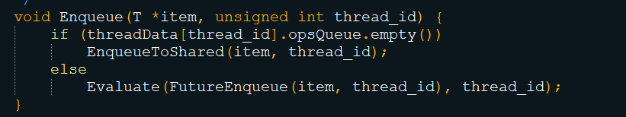
ENQUEUE
If the queue of future operations is empty (no future operations), we call to EnqueueToShared, which enqueue the item to the shared queue, using CAS.
Otherwise, we evaluate the futureEnqueue of this item.

Slide 15
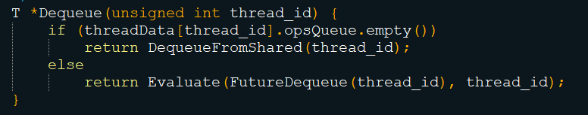
DEQUEUE
Dequeue is quite similar to enqueue. We would dequeue from the shared queue if future operation queue (of the thread) is empty.
Otherwise, we evaluate the futureDequeue of this dequeue.

Slide 16
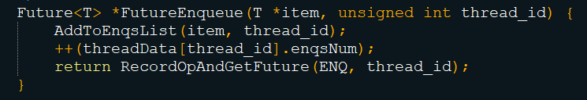
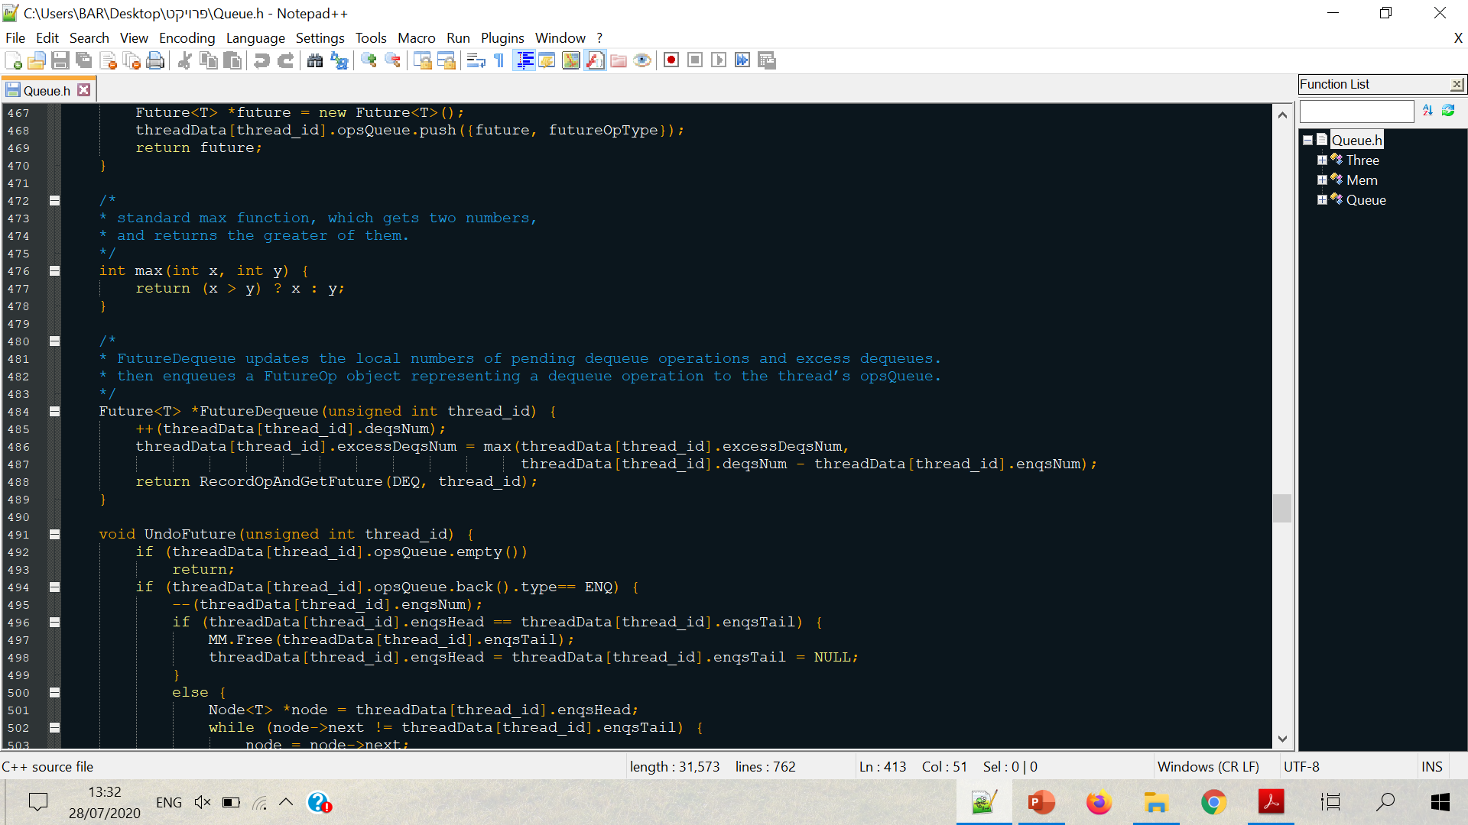
FUTURE
Future enqueue and future dequeue are similar to each other, except that enqueue adds the item to a list of item for enqueue, and dequeue calculate the excess dequeue num, using lemma proved at the article.
Both return a Future returned from calling RecordOpGetFuture function, which creates new Future and pushes the compatible future operation to the operation queue of the thread.

Slide 17
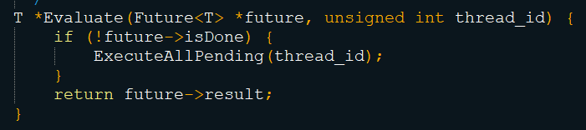
EVALUATE
Evaluate method receives a future operation and makes sure it will execute only if this future operation was submitted by the same thread that evaluated it.
When calling evaluate with a future to be execute, it will execute all the thread’s (who calls it) future operations that weren’t executed yet,

Slide 18
HOW IT IS COMPILED
-std=c++11
*.cpp –o ….
g++
-pthread
-march=native
Since we used c++11
Enable running multithreading
Enable atomic operations on 16-byte data structures

Slide 19
LIBRARIES WE USED
queue
atomic
memory
iostream
thread
For testing and performance evaluation, used for creating threads
For using atomic operations, adding memory fences and comiler fences
For testing and debugging purposes
For allocating memory by user
Using non-thread-safe queue for thread data and thread memory

Slide 20
CHALLENGES
KNOWLEDGE
DEBUGGING
COMPATIBILITY
SEARCHING
I had to learn a lot to complete this project, and extending my knowledge aiming to find solutions to problems I had.
Debugging is always a challenge, especially when running multithreading programs, where any execute yields different result.
Sometimes things worked at my computer but didn’t work at CSL3 server, or vice versa.
Sometimes I was searching for a solution to a problem all over the internet, for example, I wasn’t aware that “compare_exchange_weak” is changing the other pointer in case of failure, which led to segfaults.

Slide 21
OPTIMIZATIONS
I did not apply any significant optimizations because I couldn’t do it without changing the logic of the queue, so I found it hard to optimize the code.
For example, I was trying to optimize using prior knowledge about the queue, like one dequeuer and many enqueuers, or vice versa. Having an optimization for this means changing the whole logic of the queue.
I also thought of optimizing the queue and making it NUMA-Aware, using thread’s local memory, instead of queue’s thread-safe memory, but I was not able to do it since the thread-safe memory will be connected later to the tail of the queue, and then become shared memory, and therefore, cannot be local.

Slide 22
ADDITIONAL FEATURES
I added 2 features to the queue, which I find useful.
First one, when evaluating a batch, I thought it is useful to get a list of all the items that were dequeued in this batch.
Therefore, I overloaded the Evaluate function, getting also a queue of T* items, and it inserts those items to the queue.
Second one, I added the ability to edit the batch, since we will not execute the batch until we have “evaluate” calling (explicit or implicit), and therefore, we can edit the batch by using the method “UndoFuture”, which remove the last Future was added, or does nothing if there are no Futures.

Slide 23
PERFORMANCE AND USING EXAMPLES
03
How we evaluated
How it was performed
Testing
Using examples

Slide 24
HOW WE EVALUATED THE PERFORMENCE
DIFFERENT BATCH SIZES
4, 16, and 64 size batches, composed of future enqueues and future dequeues randomly.
DIFFERENT THREADS NUMBERS
1, 2, 4, 8, 16, 32, 64, and 128 threads running for each batch size
LETTING ALL THREADS WAKE UP BEFORE START
RUN FOR 3 SECONDS AND AND COUNT THE NUMBER OF OPERATIONS
Since we wanted all thread will start at same time
Each thread counts each batch, for 3 seconds, so we multiplied by the size of the batch and divided by 3, in order to find the number of operation per second

Slide 25
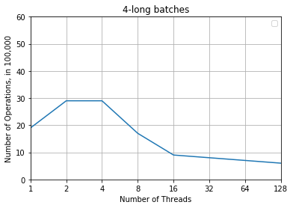
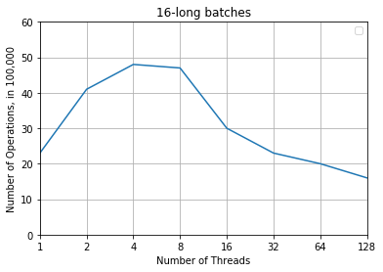
HOW IT PERFORMED
4-batch size
16-batch size

Slide 26
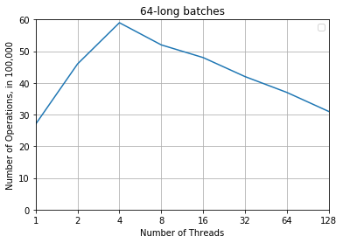
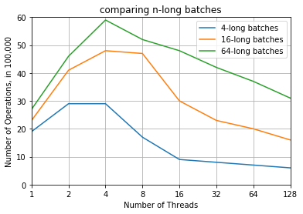
HOW IT PERFORMED
64-batch size
Conclusion
We notice that longer batch provides better performance

Slide 27
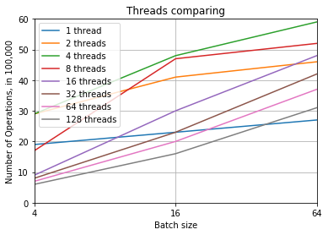
HOW IT PERFORMED
As we see, longer batch provide better performance to any number of threads.
We can also notice that longer batches in high number of threads (16 or higher), where the contention is high, provides the most significant improvement.

Slide 28
TESTING
We created unit tests, testing different aspects of the queue including enqueue, dequeue, future enqueue, future dequeue, evaluate and different combinations of those functions. We also checked the additional functions we added.
In addition, we tested the queue using valgrind, to avoid memory leaks and memory errors, as well as ABA problem and other problems.

Slide 29
USING EXAMPLE: POST OFFICE EXAMPLE
There is a post office, where 4 people are responsible of receiving packages and inserting it to the handling queue and 4 other people that handle the packages for delivering it, and removing it from the handling queue.
Each of the workers, will use batching.
A worker that inserts packages must insert the packages in a bunch of up to #n packages (with also restriction of time).
A worker that handles packages dequeues #m packages at once, and then handle all.

Slide 30
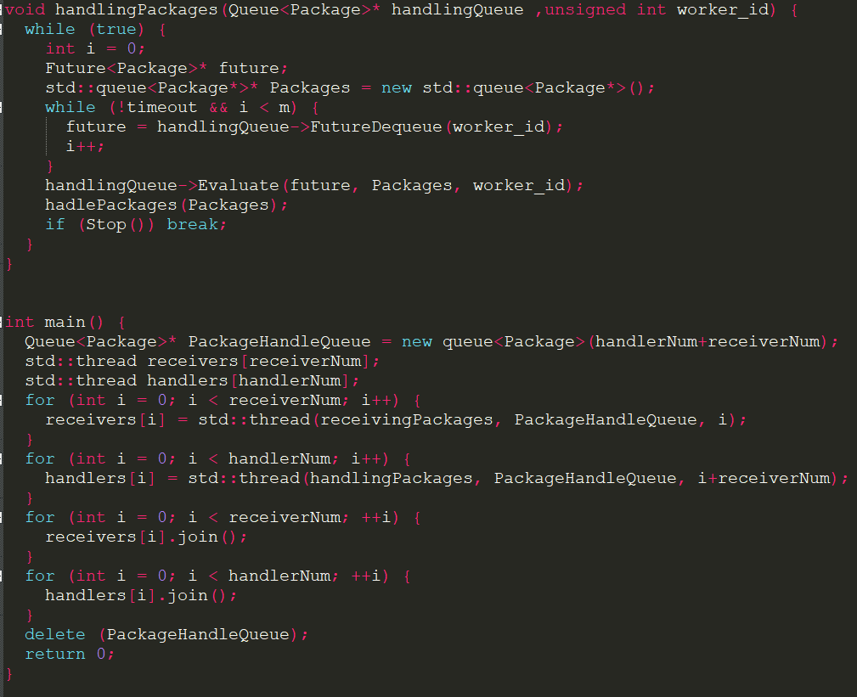
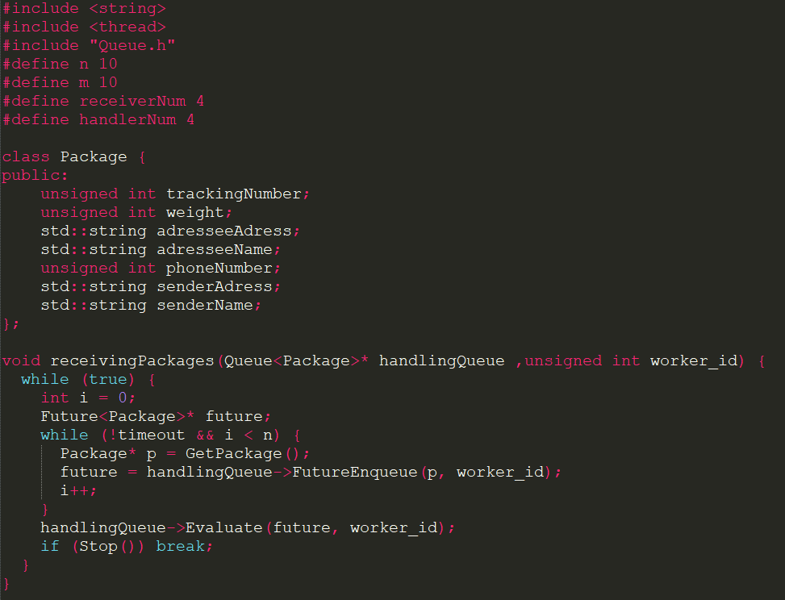
USING EXAMPLE: POST OFFICE EXAMPLE
Implementation of post-office example:

Slide 31
THANKS
Bar Arviv
Bar.a@campus.technion.ac.il
+972 504 974 200
github.com/BarArvive/BatchQueue

